Slide 1
Single Phase Half H Bridge Inverter
Course No: ECE 3206
Course Title: Industrial Electronics Sessional

Slide 2




Our team
Sumaiya Tabassum
Mahbuba Habib
Marjia Afroz
1810026
1810029
1810023

Slide 3
Contents: 1. Introduction 2. Components 3. Working Principle 4. Project Video 5. Cost Analysis 6. Conclusion
March 16, 2023

Slide 4
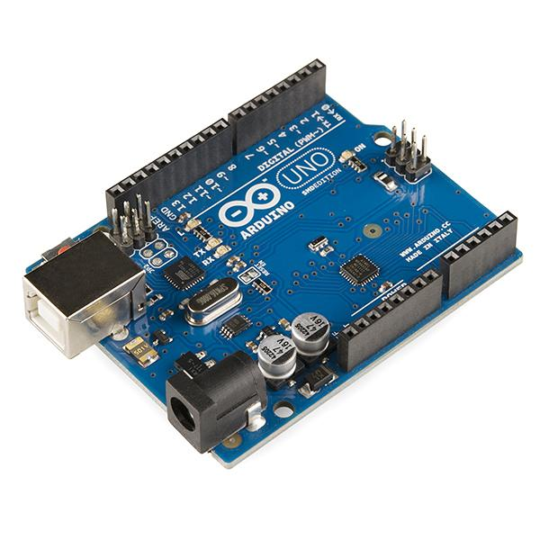
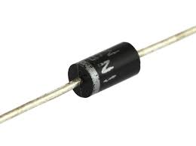
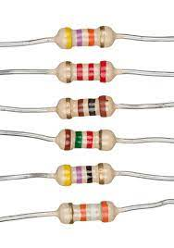
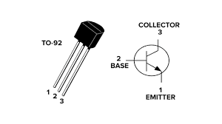
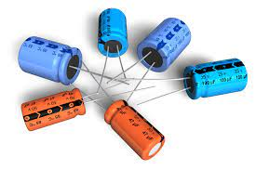
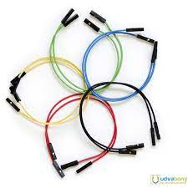
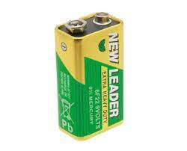
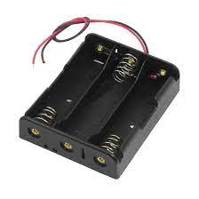
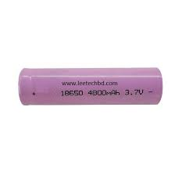
Components
Arduino Uno
Resistor (10K, 100K)
Capacitor (50V ,220uF)
Battery(3.9 V)
Battery Holder
Diode
Transistor
Wire(As necessary)

Slide 5
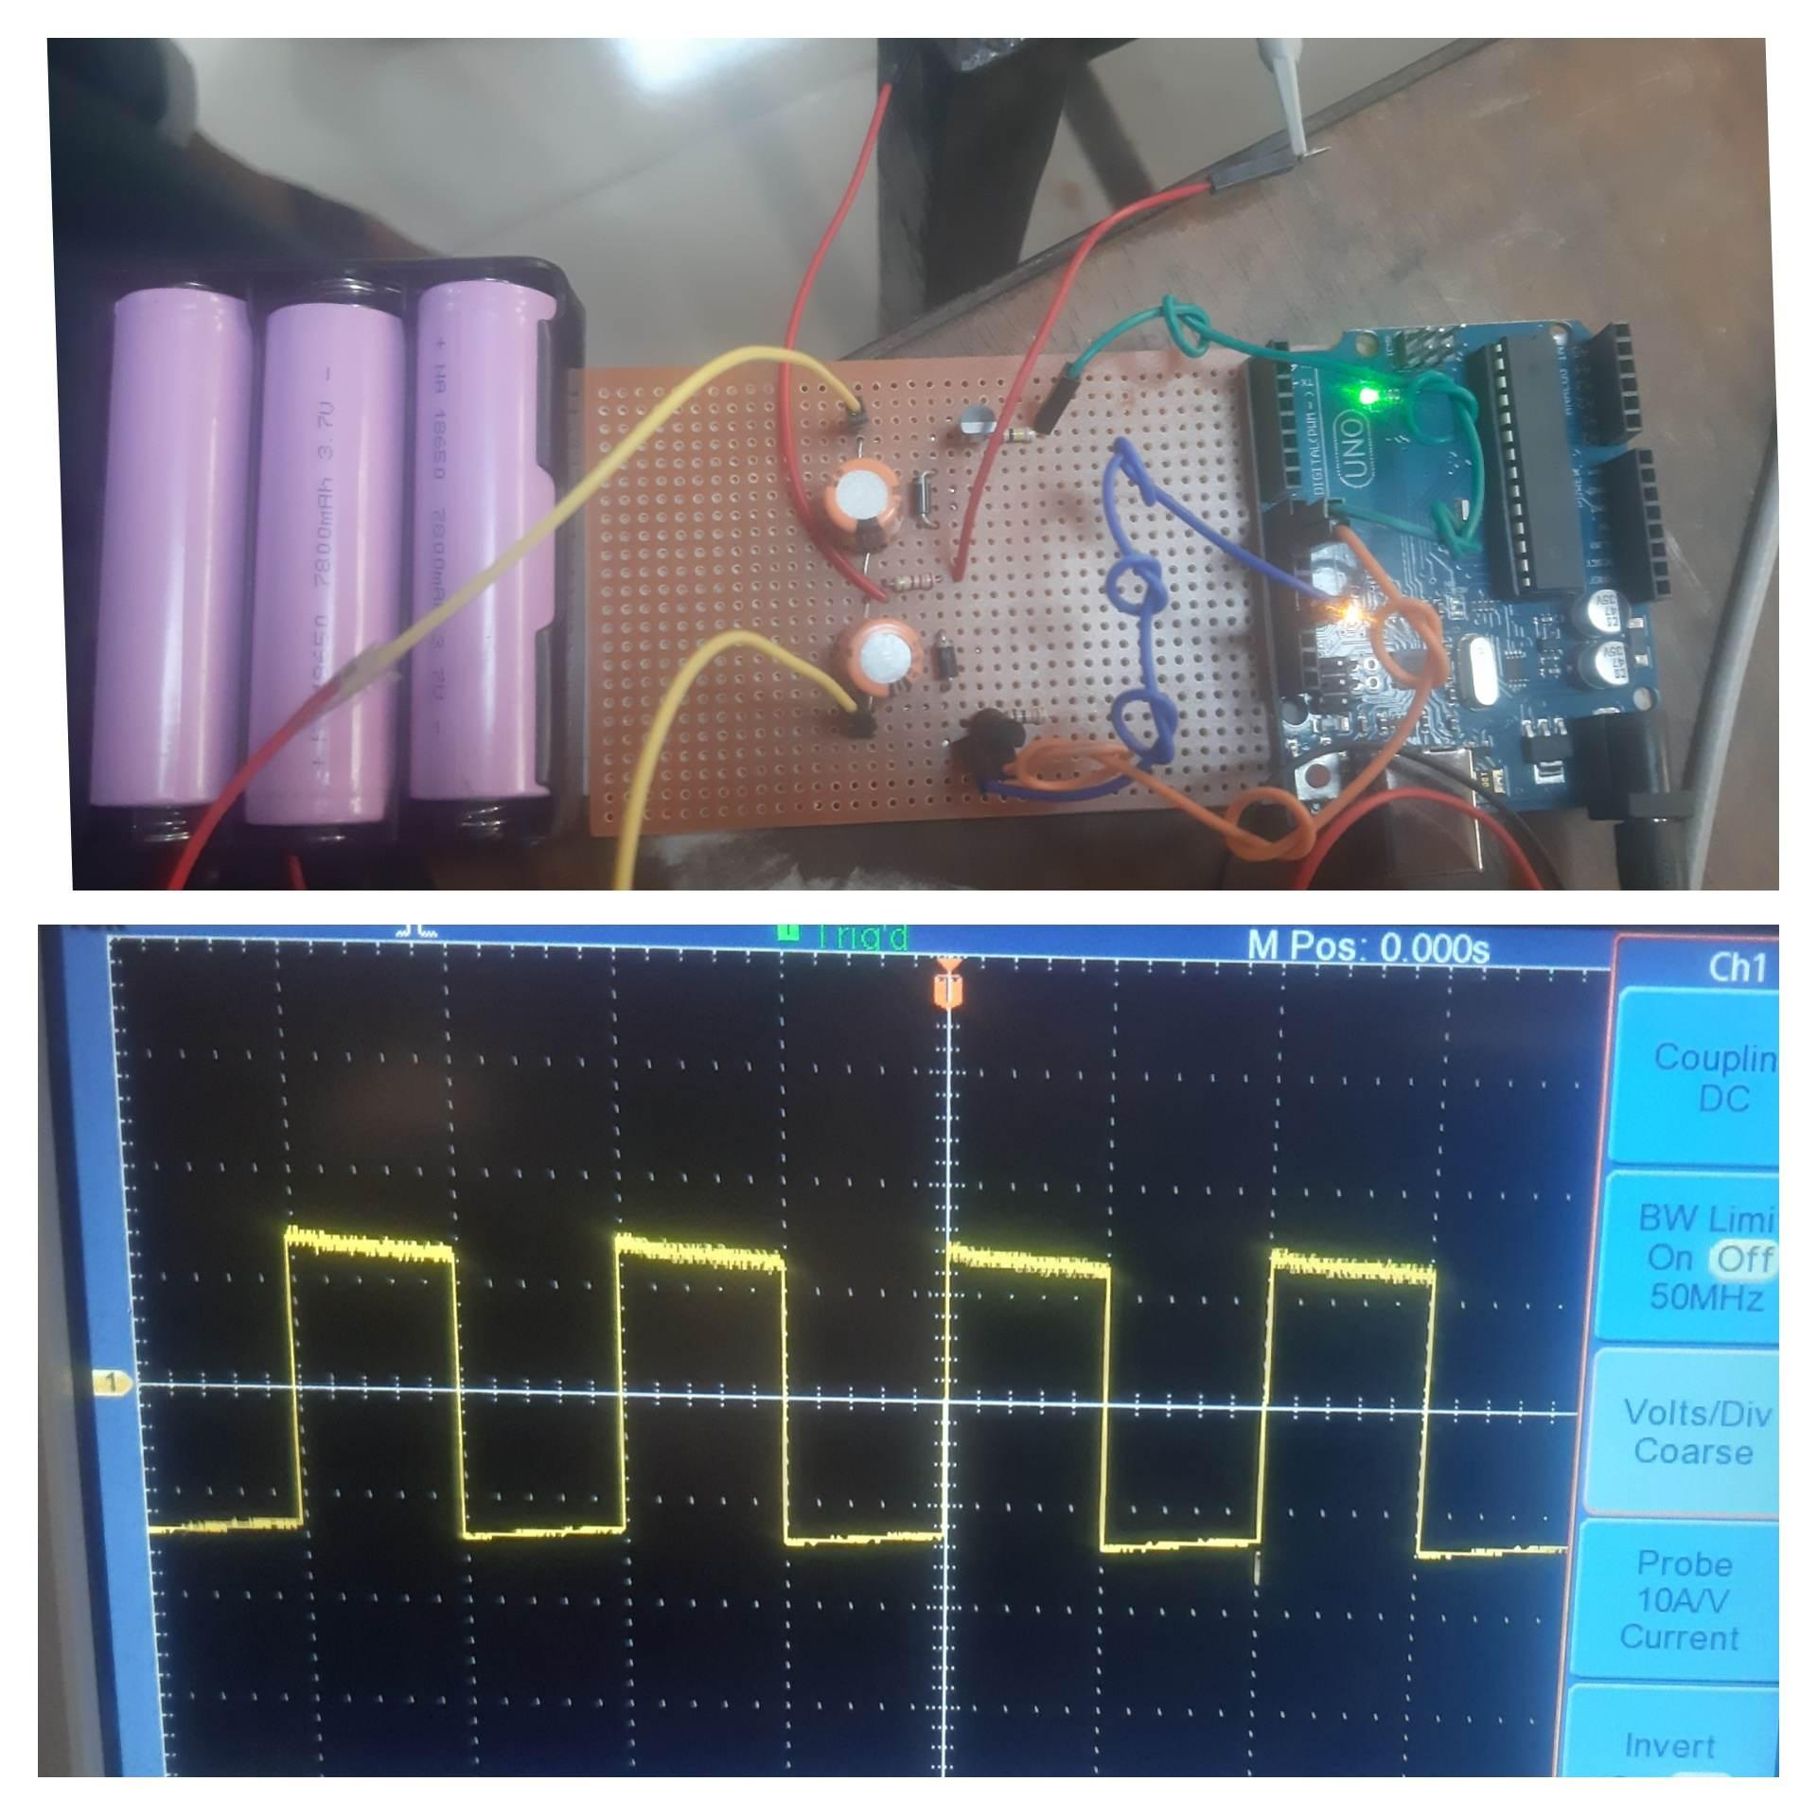
Introduction
Single Phase Half H-bridge is one of the inverter topologies which convert DC into AC. It is a voltage source inverter. Voltage source inverter means that the input power of the inverter is a DC voltage Source & output is AC.

Slide 6
Working Principle:
The circuit is designed in such a way that both switches must not turn-on at a single time & only one of the two switches will conduct. Each switch will operate for half period (T/2), providing half of the applied voltage the load (± V_{dc}/2). When both the switches are off, the reserved voltage across the load will be V_{dc} instead of V_{dc}/2. This is called a half-bridge inverter.

Slide 7
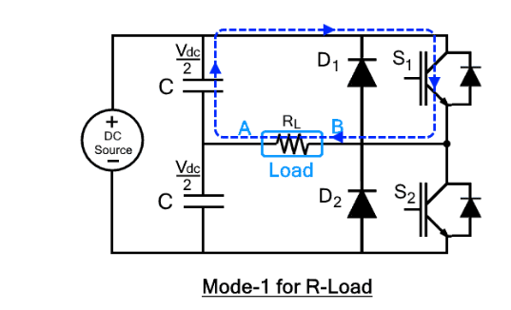
Working Principle:
The circuit with this load will be operated in just two modes.
Mode 1: (0<t<T/2)
In this mode, S₁ is turned-on from time interval t=0 to t=T/2 while S₂ is turned off. As soon as S₁ is turned on, the voltage across the load will appear. The output voltage across the load will be
V_{o} = V_{dc}/2

Slide 8
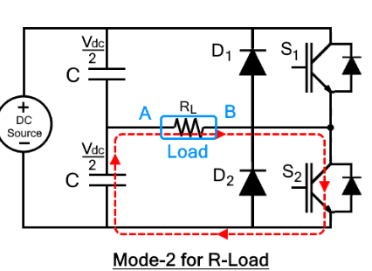
Working Principle:
Mode 2: (T/2<t<T)
In this mode, switch S₂ is turned­-on from the time interval t=T/2 to t=T while S₁ is switched off. Immediate switching of modes is avoided because it causes a short circuit. Due to this reason, S₂ is turned-on with some delay after S₁ is completely turned off. In this case, the output voltage will be negative as the current enters in the load from the opposite direction where output voltage will be
V_{o} = -V_{dc}/2

Slide 9
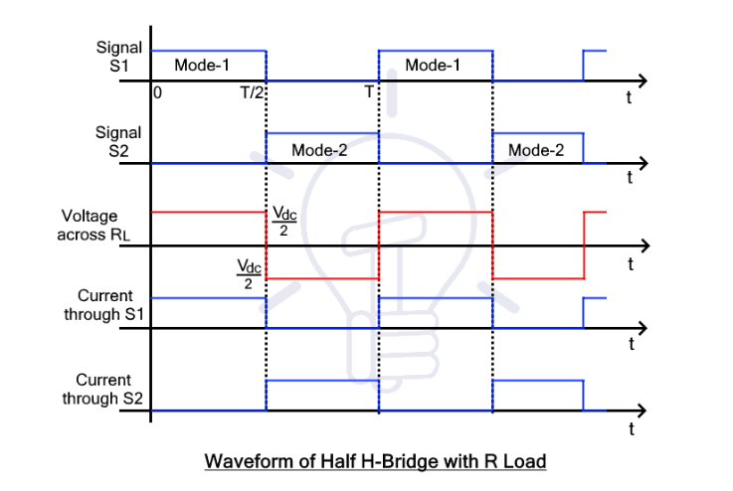
Waveform of Half H Bridge with R Load:

Slide 10
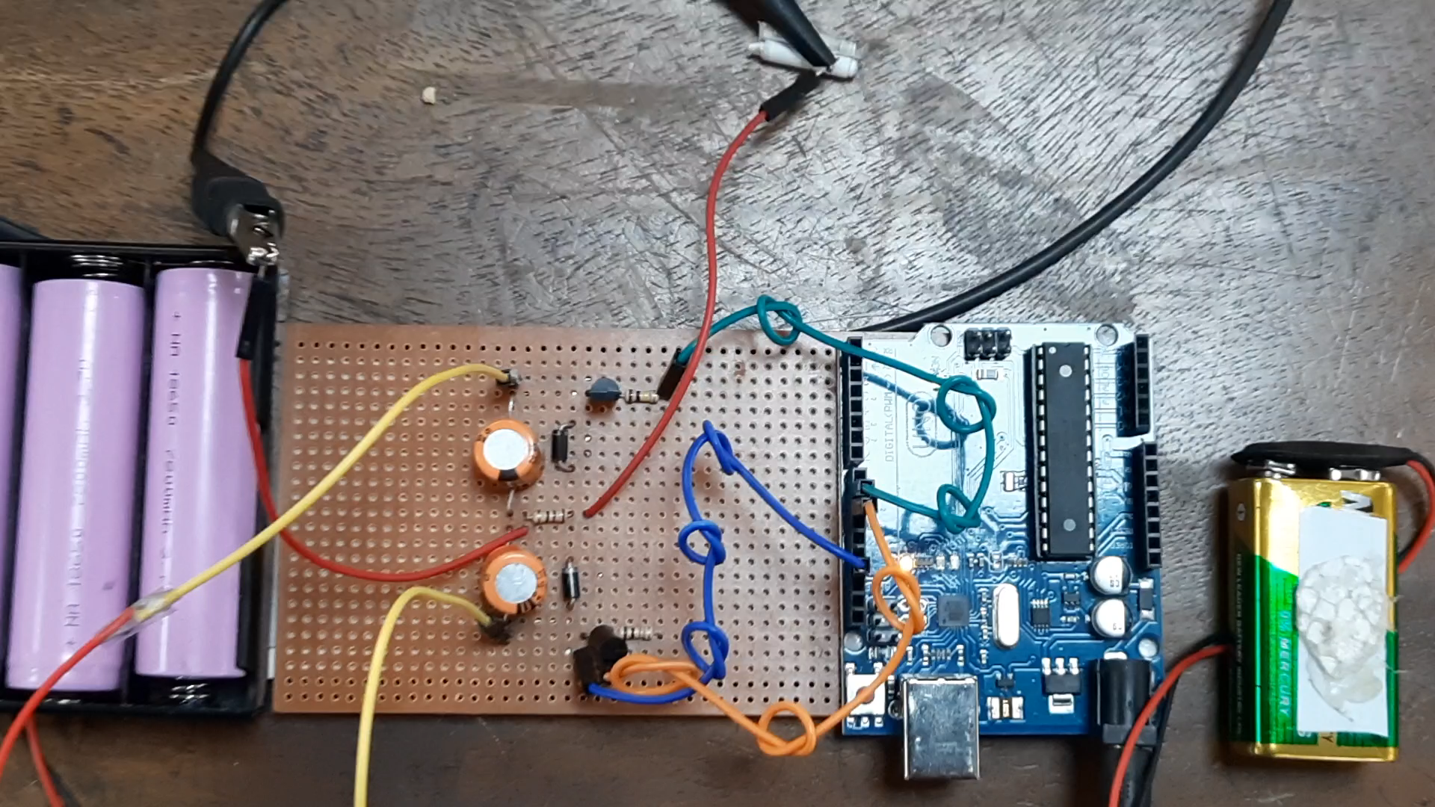
Project Video:

Slide 11
Cost Analysis
Component | Price
Arduino | 1050
Resistor | 8
Capacitor | 10
Battery | 330
Battery Holder | 50
Diode | 10
Transistor | 120
Wire | 20
Veroboard | 30
9V Battery Supply | 75
Total Price | 1703

Slide 12
Conclusion
From the setup, the output voltage is approximately equal to half of the applied voltage. Thus single phase half H bridge inverter is successfully implemented here.

Slide 13

Thank you

